Slide 1


EBRARY
Your online reading Utopia

Slide 2


GROUP4
JUNYU LIU
YING LU
ZHAOJIE LIU
HANBAI ZHAO
ZEFAN FENG
strategy plane

Slide 3


1. UX METHODS
2. UX PRINCIPLES
3. SKELETON & SURFACE PLANE
4. GOOGLE MATERIAL DESIGN
5. SELENIUM TESTING

Slide 4

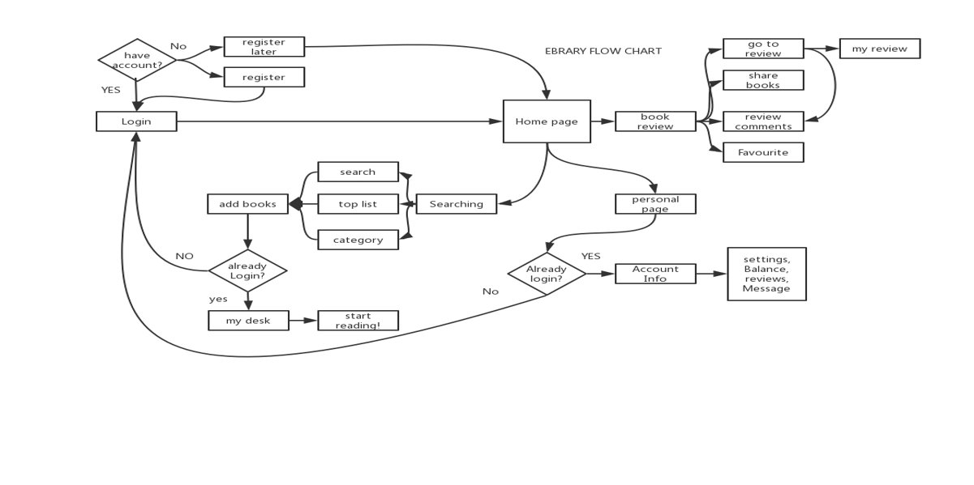
Quick review
0

Slide 5
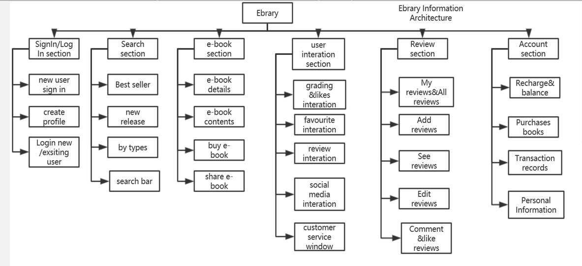
Quick review
0

Slide 6

UX METHODS
INTERUPT INTERVIEWS
QUESTIONAIRE
USER FEEDBACK
USABILITY TESTING
1

Slide 7
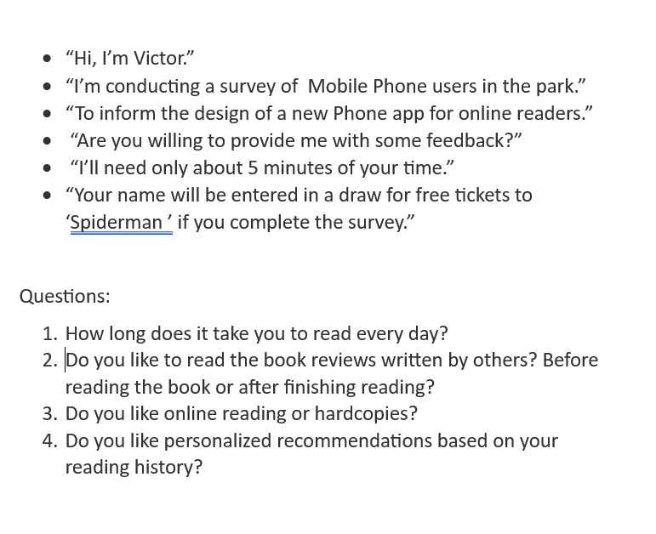


UX METHODS-INTERUPT INTERVIEW

Slide 8
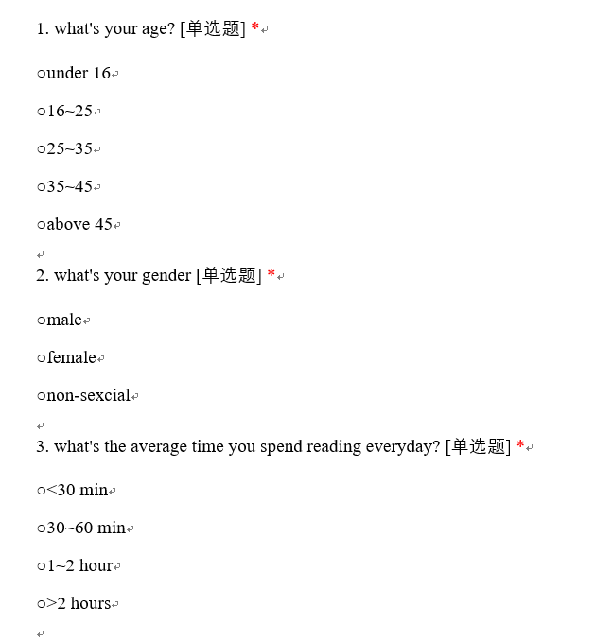
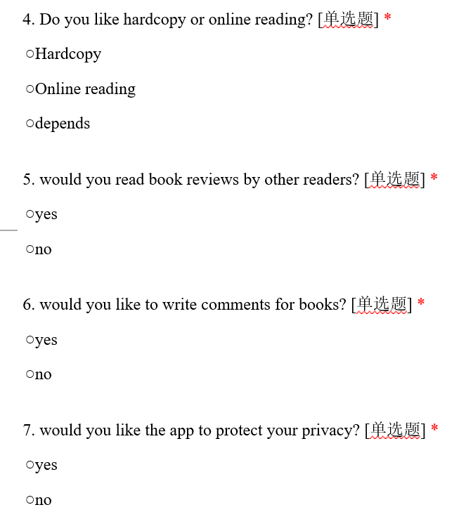
UX METHODS-QUESTIONAIRE

Slide 9
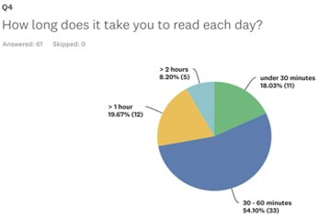
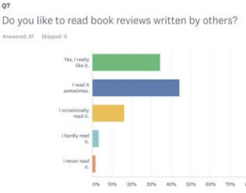
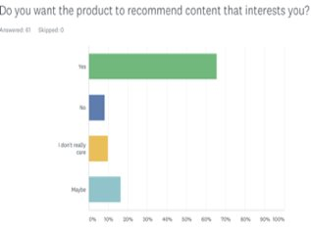
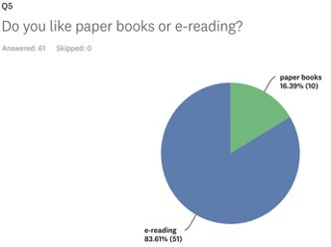
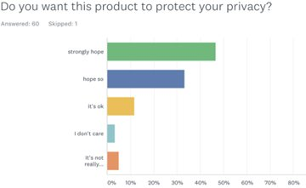
UX METHODS-QUESTIONAIRE

Slide 10
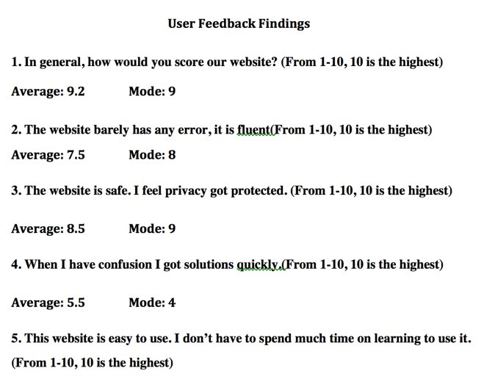
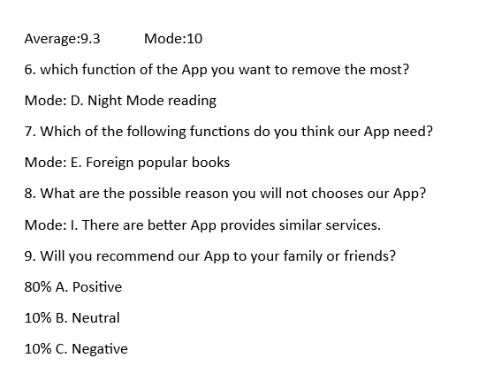
UX METHODS-USER FEEDBACK

Slide 11
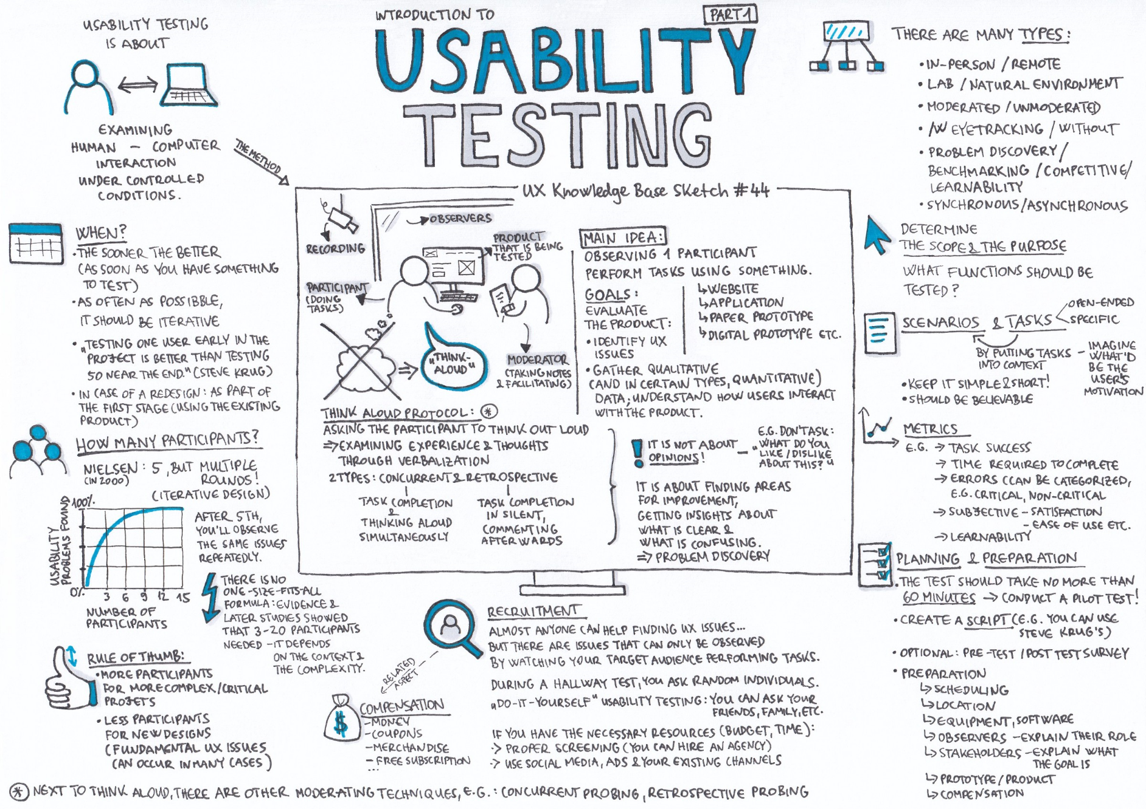
4
5 tasks for usabulity testing
TASK | DESCRIPTION
1 | Look up for and favorite the newest publishment of author Jojo Moyes
2 | Register and sign in a new account
3 | Establish a private review and a public review for the book
4 | Charge the account to read more
5 | Establish a comment on book reviews of other readers

Slide 12
USABILITY TESTING
Task/ User | User1 | User2 | User3 | User4 | User5 | User6 | User7 | User8 | User9 | average | Experienced
1(Expected 35s ) | 25s | 27s | 40s | 1min | 55s | 45s | 1m2s | 54s | 45s | 40.5s | 25s
2(Expected 1m10s ) | 42s | 1m | 1m30s | 1m15s | 1m14s | 1m33s | 59s | 1m22s | 1m29s | 1m5s | 1m
3(Expected 1m) | 42s | 50s | 55s | 59s | 58s | 1m3s | 1m20s | 49s | 55s | 57s | 50s
4(Expected 45s) | 29s | 40s | 39s | 49s | 47s | 59s | 55s | 1m3s | 1m | 49s | 40s
5(Expected 40s ) | 38s | 37s | 39s | 43s | 40s | 45s | 33s | 54s | 34s | 40.3s | 30s

Slide 13
UX METHODS
The process used to find a solution.
Most of candidates interviewed don’t like to read the review before because some of the book review have spoiler, which is very annoying, also, they don’t want to follow other’s thoughts to go through the book. And some of them don’t want fake trash reviews like the reviewer just made something up and after you reading it makes you feel you don’t want to read it, but they have not even read it.
The problem to be solved.
Readers said they want to add reviews and be able to see other’s reviews.
1
2
The key deliverables.
1.As for our business goal is to encourage people buy books on our web site, and we want them to feel comfortable when using it, we don’t want them be annoyed by others as well.
2.User Journeys and User Flows,
3.UX Wireframes,
4.Interactive Prototypes.
3
4
The outcome and results.
So, first readers can add reviews only after they buy the book, if you don’t have the book, you can’t add reviews. Then, we added book review spoiler brush, the people who writes reviews can brush their spoiler, thus, if they don’t want to be interrupted, they won’t interrupt others.

Slide 14
UX PRINCIPLES
2

Slide 15
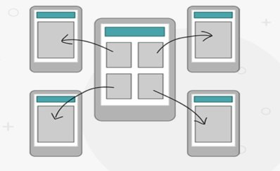
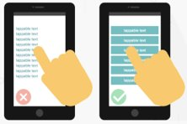
UX PRINCIPLES
1. Content Prioritization
Grab users’ attention within the first few seconds of interaction with our products.Less is more. When designing our products, keep interface elements to a minimum. Simple designs are what keep the user engaged and at ease with products.
2. Make Navigation Intuitive
Users should intuitively be able to navigate through our app via clear pathways and be able to complete all primary tasks without requiring any explanations.
3. Touchscreen Target Sizes
Make interface elements big enough to capture users’ actions. Small touch targets can be frustrating because they require more accuracy and are prone to errors. Not only is the size of the target important, but so is the spacing between targets.
4. Provide User Control
People like to feel like they’re in control of their actions. So that’s what we need to give them. Changing settings, controlling notifications and cancelling actions provides the user with a sense of control over the system. Apps can suggest actions or provide warnings, but they shouldn’t be the ones doing the decision-making.

Slide 16
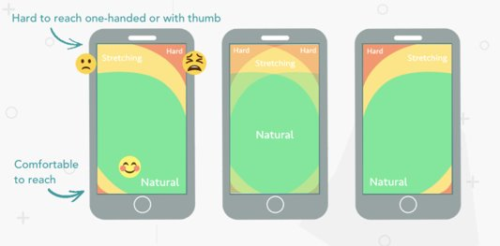
UX PRINCIPLES
5. Legible Text Content
Communicating our designs in a clear, simple layout delivers our message effortlessly. Spacing and layout are also important to improve legibility. Adding space between text aids the user in reading and creates a feeling that there isn’t so much information to take in.
6. Make Interface Elements Clearly Visible
It’s important to have sufficient contrast between content and background in our designs so it’s legible, in any setting, even outside under the sunlight.
7.Hand Position Controls
Hand positions should be kept in mind when placing controls on a mobile design. Delivering a great mobile UX takes into consideration all different types of users.
8. Minimize Data Input
Looking for shortcuts and efficient ways to help users get things done.

Slide 17

UX PRINCIPLES
9. Create a Seamless Experience
Focus on key user goals by reducing friction, minimizing steps and page loads to decrease interaction time.
10. Test Your Design
The earlier we discover our problems, the easier and cheaper it is to fix them.

Slide 18
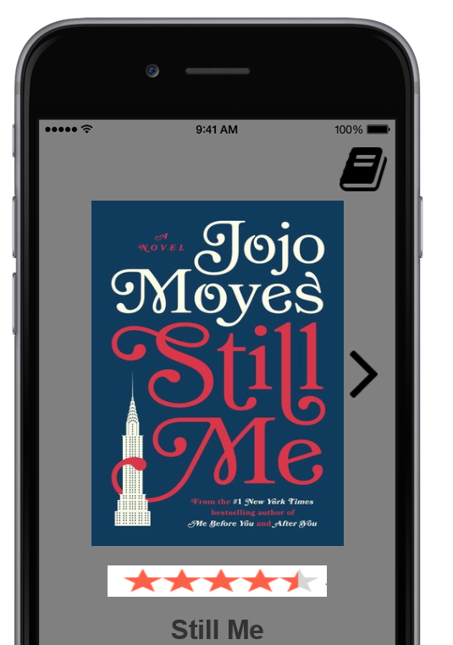
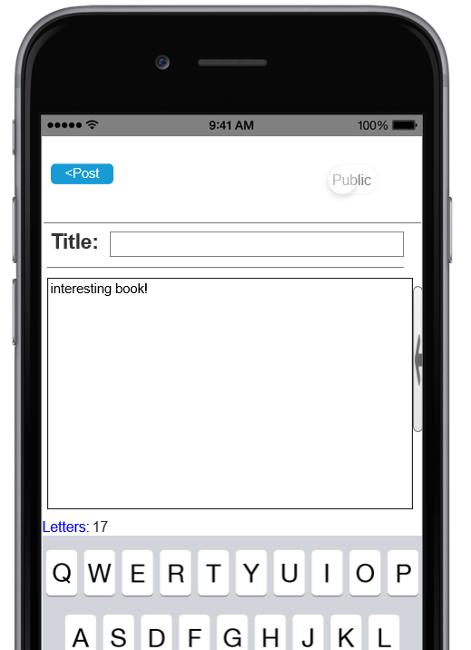
SKELETON PLANE
Interface Design
Use hint to prompt the user for the textfield
Use the action button to prompt the user to start reading directly
3

Slide 19
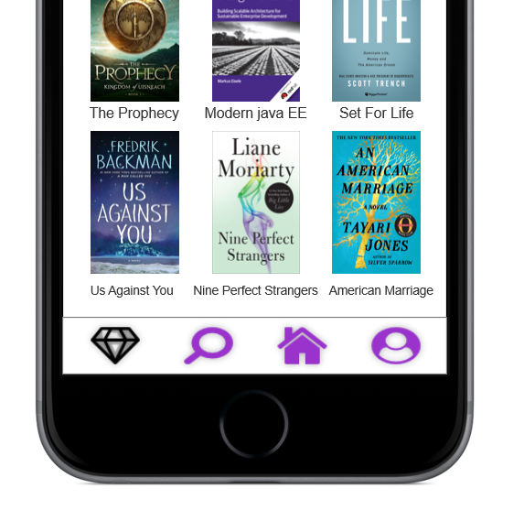
SKELETON PLANE
Navigation design
Global Navigation
Local Navigation
Supplementary Navigation
The bottom navigation bar:​
​
Visible and structured (using 4 top-level targets to avoid scrollable content)​
Clear (element is easy to navigate, target is easy to click)​
Concise (each icon points to a fixed page, all elements remain consistent)
3

Slide 20

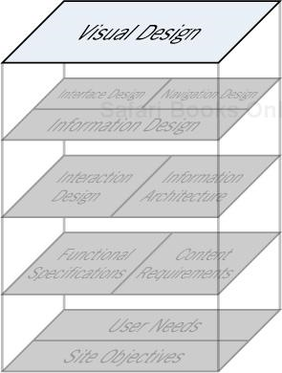

3
SURFACE PLANE
contrast：​
Contrast is one of the main tools we use to draw attention to users. The contrasting function is to bring the user's attention to the key parts of the interface, to help the user understand the relationship between the page navigation elements, and to convey the concept group in the information design.​
Internal consistency：​
Internal consistency means that two different parts of the product reflect the same design approach.
Different pages using same light grey background color and button; To emphasize the area of the book review, we use white background to Maintain internal consistency

Slide 21
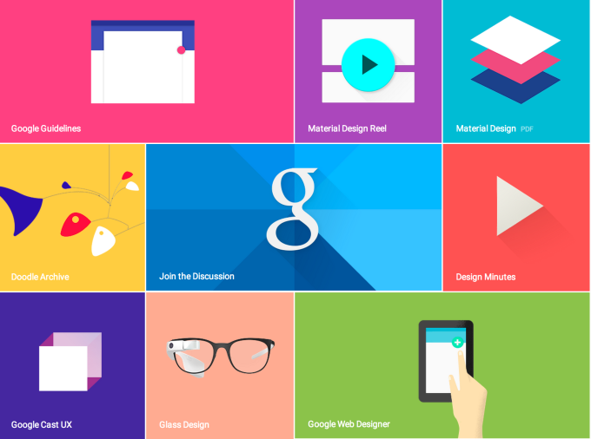
GOOGLE MATERIAL DESIGN
Material Design is a visual language that synthesizes the classic principles of good design with the innovation of technology and science.
Material Design Principles
4
1.Material is the metaphor​
2.Bold, graphic, intentional​
3.Motion provides meaning​

Slide 22
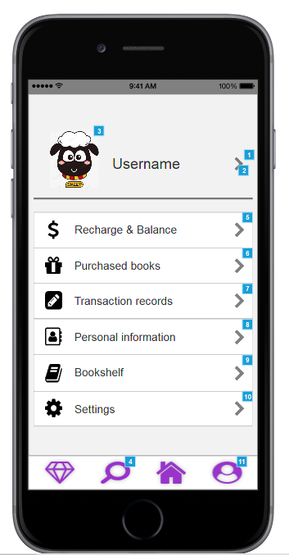
GOOGLE MATERIAL DESIGN
Material Design in Ebrary
Material: By casting shadows on objects, we make the elements on app acting as a 3-dimensional objects in reality,implementing material’s metaphor design principle .​
Icons: Google Material Icons Library is imported in our app to make it easier for users to fetch app’s core idea, button’s functionality and capabilities.​
Motion: We strive to provide more motion to maintain continuity between views .As elements appear on screen, they transform and reorganize the environment, with interactions generating new transformations.

Slide 23
SELENIUM TESTING
Axure Prototype: https://zvcwk2.axshare.com/#c=2
5

Slide 24

THANKS
You knew that was not the impossible matter you to believe eventually I was very disappointed to you I thought you could understand me

